Slide 1
From the makers of
Introducing:
Wholly-owned subsidiary of Greens First
Comprehensive product line addresses wide range of female health issues
Developed and endorsed by board-certified OB/GYNs

Slide 2
For natural relief of symptoms associated with all stages of Menopause*
*These statements have not been evaluated by the Food and Drug Administration. This product is not intended to diagnose, treat, cure or prevent any disease.

Slide 3
About
Providing a comprehensive natural product line to over 10,000 health care professionals for more than 15 years
Greens First Pro enriched with 54 super foods, digestive enzymes, probiotics and more to create an alkaline-rich internal environment for optimum human health
15+ servings of fruits and vegetables in every scoop*
Flagship product voted “Best Tasting” greens product in its category
*Based on Total ORACFN testing
Notes:
Waiting for new product image

Slide 4
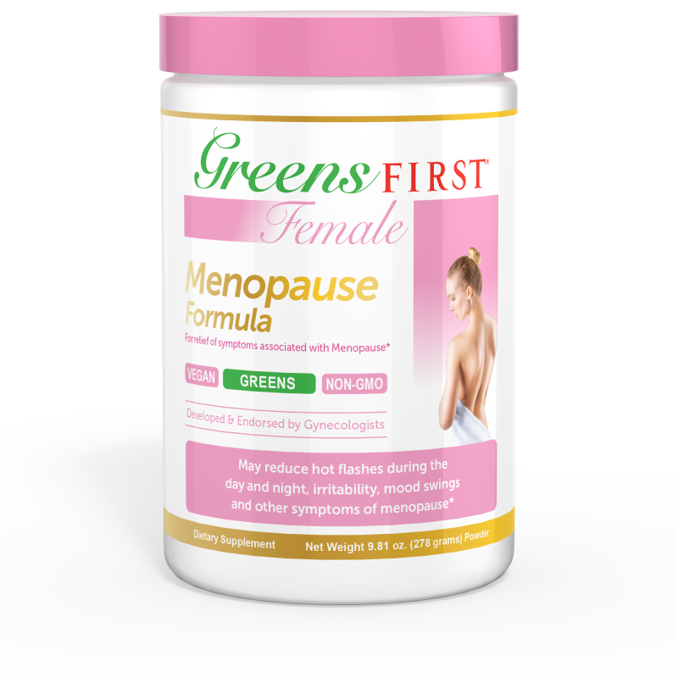
Introducing the first proprietary product from the GFF line…
For natural relief of symptoms associated with all stages of menopause*
Weight gain
Bone density issues
Hot flashes
Night sweats
Mood swings
Sleep disturbance
Hormonal imbalance
Low libido
*These statements have not been evaluated by the Food and Drug Administration. This product is not intended to diagnose, treat, cure or prevent any disease.

Slide 5
For natural relief of symptoms associated with all stages of Menopause*
Why Natural?
“With all that we know about the pitfalls of conventional medicine's treatment of women in menopause, it makes sense that women are turning to natural approaches to relieve menopausal discomforts.” – John R. Lee, MD
Possible Risks Associated with Traditional Hormone Replacement Therapy
Increased
clotting
Cancer
Stroke
Heart Attack
Breast
Uterine
Ovarian
*These statements have not been evaluated by the Food and Drug Administration. This product is not intended to diagnose, treat, cure or prevent any disease.

Slide 6
For natural relief of symptoms associated with all stages of Menopause*
Addresses Growing Market for Natural Female Products
37.5 million U.S. women are at or near menopause¹
45.6 million are postmenopausal¹
Traditional HRT use is steadily decreasing
Women are demanding effective remedies that reduce symptoms without the risk of breast and uterine cancers, heart disease and stroke.
¹Source: Natural Products Insider
*These statements have not been evaluated by the Food and Drug Administration. This product is not intended to diagnose, treat, cure or prevent any disease.

Slide 7
For natural relief of symptoms associated with all stages of Menopause*
In addition to the benefits of the Greens First formula, Greens First Female Menopause is designed to:
Support healthy hormonal balance
Reduce frequency and intensity of hot flashes
Reduce irritability and mood swings
Reduce sleep disturbances
Improve low libido
Help control menopausal weight gain
Help keep bones dense, healthy & strong
Maximize health & improve overall well-being
*These statements have not been evaluated by the Food and Drug Administration. This product is not intended to diagnose, treat, cure or prevent any disease.

Slide 8
For natural relief of symptoms associated with all stages of menopause*
Contains Clinically Proven Ingredients
Graminex® G60® (Flower Pollen Extract)
Moringa Leaf
Daidzein
Cnidium Monnieri
Vitamin B3 (Niacin)
Royal Jelly
Guggul Gum
Chromium Picolinate
Pantothenic Acid
*These statements have not been evaluated by the Food and Drug Administration. This product is not intended to diagnose, treat, cure or prevent any disease.

Slide 9
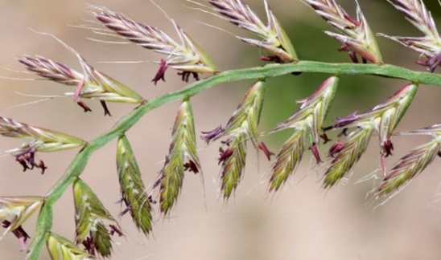
For natural relief of symptoms associated with all stages of menopause*
GRAMINEX® G-60® (Flower Pollen Extract)
Dramatically reduces hot flashes
Reduces frequency & intensity of night sweats
Provides weight management support
Decreases fatigue and irritability
*These statements have not been evaluated by the Food and Drug Administration. This product is not intended to diagnose, treat, cure or prevent any disease.
Notes:
Website says “Graminex G63”

Slide 10
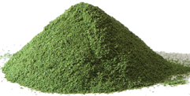
For natural relief of symptoms associated with all stages of menopause*
Moringa Leaf Powder
Vitamins, minerals, amino acids
Vitamin D, calcium for bone health and may help prevent osteoporosis
May help lower LDL
Helps control blood sugar
Regulates mood swings
Reduces fatigue
Increases libido
*These statements have not been evaluated by the Food and Drug Administration. This product is not intended to diagnose, treat, cure or prevent any disease.

Slide 11
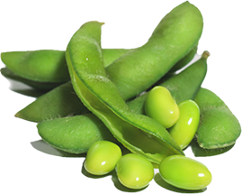
For natural relief of symptoms associated with all stages of menopause*
Daidzein
Contains isoflavone C₁₅H₁₀O₄ -a natural bio-identical phyto-estrogen
Rich in phenolic acids
May reduce hot flashes
*These statements have not been evaluated by the Food and Drug Administration. This product is not intended to diagnose, treat, cure or prevent any disease.

Slide 12
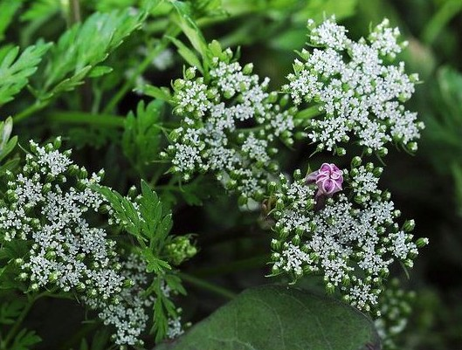
For natural relief of symptoms associated with all stages of menopause*
Cnidium Monnieri
Used for centuries in Traditional Chinese Medicine
Boosts libido
*These statements have not been evaluated by the Food and Drug Administration. This product is not intended to diagnose, treat, cure or prevent any disease.

Slide 13
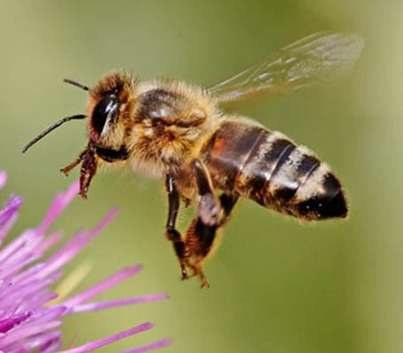
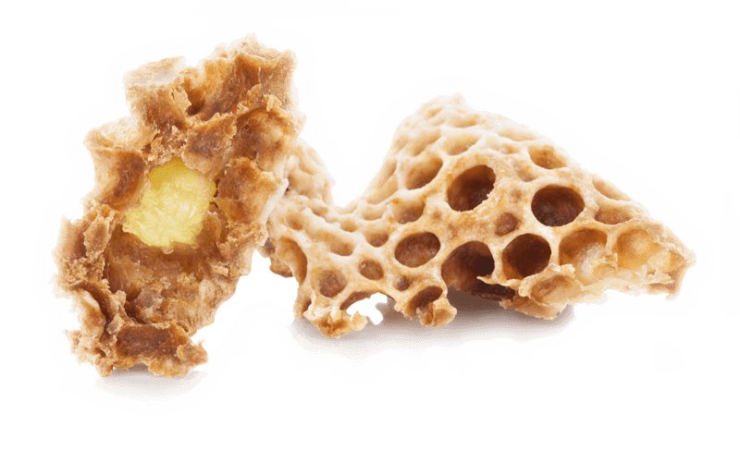
For natural relief of symptoms associated with all stages of menopause*
Royal Jelly
Loaded with minerals, vitamins, protein and pheromones
Plant-based phyto-estrogens
Supports adrenal function
Supports stress management
Helps reduce hot flashes
Helps reduce fatigue
May strengthen bones
*These statements have not been evaluated by the Food and Drug Administration. This product is not intended to diagnose, treat, cure or prevent any disease.

Slide 14
For natural relief of symptoms associated with all stages of menopause*
Guggul Gum
Helps reduce tryglicerides
Helps lower LDL
Assists in weight loss
Helps balance hormones
Reduces hot flashes
*These statements have not been evaluated by the Food and Drug Administration. This product is not intended to diagnose, treat, cure or prevent any disease.

Slide 15
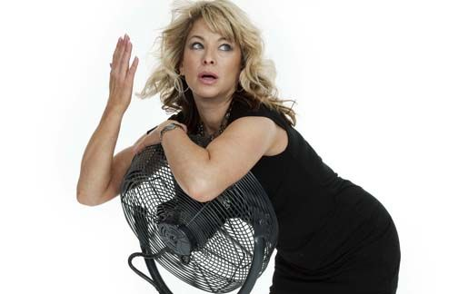
For natural relief of symptoms associated with all stages of menopause*
Vitamin B3 (Niacin)
Reduces frequency and intensity of hot flashes
Soothes menopausal stress
*These statements have not been evaluated by the Food and Drug Administration. This product is not intended to diagnose, treat, cure or prevent any disease.
Notes:
Leaving additional photos in margin in case you want to swap out.

Slide 16
For natural relief of symptoms associated with all stages of menopause*
Pantothenic Acid
Reduces acne breakouts
Helps maintain emotional balance
Helps reduce stress, depression and anxiety
Reduces physical discomfort associated with estrogen deficiency
*These statements have not been evaluated by the Food and Drug Administration. This product is not intended to diagnose, treat, cure or prevent any disease.

Slide 17
For natural relief of symptoms associated with all stages of menopause*
Chromium Picolinate
Modulates blood sugar
Aids metabolism
Reduces food cravings
Regulates fat and cholesterol
Prevents hypertension
*These statements have not been evaluated by the Food and Drug Administration. This product is not intended to diagnose, treat, cure or prevent any disease.

Slide 18
For natural relief of symptoms associated with all stages of menopause*
Supportive Research
Graminex® G60® (Flower Pollen Extract)
http://www.graminex.com/clinical-studies.php
http://www.graminex.com/graminex/file/57_findings_on_female_menopausal_disorders_through_the_pollen_extract_g63_of_graminex_company.pdf
Moringa Leaf Powder
http://www.webmd.com/vitamins-supplements/ingredientmono-1242-moringa.aspx?activeingredientid=1242
http://articles.mercola.com/sites/articles/archive/2015/08/24/moringa-tree-uses.aspx
Daidzein
http://www.ncbi.nlm.nih.gov/pmc/articles/PMC3207039/
http://www.ncbi.nlm.nih.gov/pubmed/18257146
Cnidium Monnieri
http://www.webmd.com/vitamins-supplements/ingredientmono-1098-cnidium.aspx?
Royal Jelly
http://www.beepollenhub.com/royal-jelly-benefits/
Guggul Gum
https://www.thebeautyinsiders.com/is-guggul-gum-resin-effective-for-hot-flashes-and-menopause.html
Vitamin B3 (Niacin)
http://www.myvmc.com/symptoms/hot-flushes-in-menopause-hot-flashes-night-sweats/
Pantothenic Acid
http://www.healthspan.co.uk/menopause-advice/depression/soothing-menopausal-stress-with-vitamin-b
https://www.womens-health-concern.org/help-and-advice/factsheets/focus-series/diet-nutrition-menopause/
Chromium Picolinate
http://www.newsmax.com/FastFeatures/chromium-health-benefits-nutrition/2011/01/21/id/369681/
*These statements have not been evaluated by the Food and Drug Administration. This product is not intended to diagnose, treat, cure or prevent any disease.

Slide 19
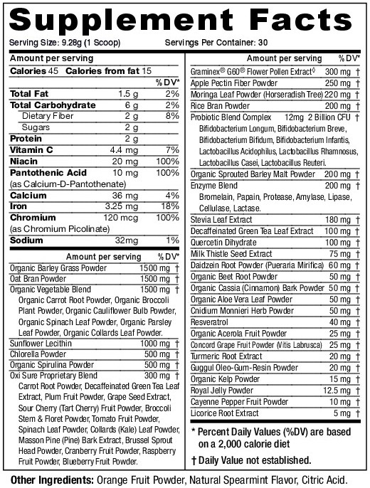
• 100% natural-contains certified organic fruits and vegetables
• Non GMO
• Sweetened with stevia
• Vegetarian and vegan
• Easy to digest
• No nano particles
• No MSG or yeast
• No corn, wheat or nuts
• No dairy, eggs or animal by- products
• No artificial ingredients, sweeteners or
preservatives
• Rich in alkaline nutrients to balance
our body’s pH levels
• SOMETHING UNEXPECTED: TASTES GREAT

Slide 20
Product Portfolio Includes:
GFF Original Mint
GFF PMS
GFF Fertility
GFF Pre-natal
GFF Menopause
GFF Green Tea Vitality enhanced with Moringa
GFF Women’s Health Pro-Biotic
Notes:
Place this as last slide?

Slide 21
For natural relief of symptoms associated with all stages of menopause*
Patient Acquisition
Custom script pad with ordering instructions
Individual codes for backend accounting
Automated sales tracking
Office inventory (optional)
Seamless transaction
Uncompromising Support
*These statements have not been evaluated by the Food and Drug Administration. This product is not intended to diagnose, treat, cure or prevent any disease.

Slide 22
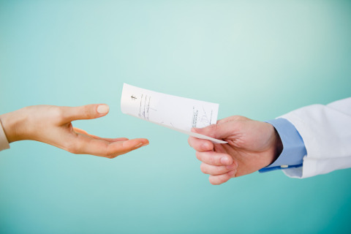
For natural relief of symptoms associated with all stages of menopause*
Dollars and Sense
Suggested retail price | $ 39.99
Health care provider cost | $ 21.99
Potential Profit per unit | $ 18.00
24 cans (2 cases) | $ 432.00
72 cans (6 cases) | $1,296.00
*These statements have not been evaluated by the Food and Drug Administration. This product is not intended to diagnose, treat, cure or prevent any disease.
Notes:
Title change?

Slide 23
Contact Information:
Gwen Friedman
Account Executive
Greens First Female LLC
O: 1.844. GFFemale (1.844.433.3625)
M: 516.852.2507
gwen@greensfirst.com

